Slide 1
CO5- ASSESSMENT TOOL 2 Technical Presentation
CSA1709 - Artificial Intelligence
GUIDED BY :
Dr.P.Rajaram
PRESENTED BY :
B.Bhavana(192312428)

Slide 2
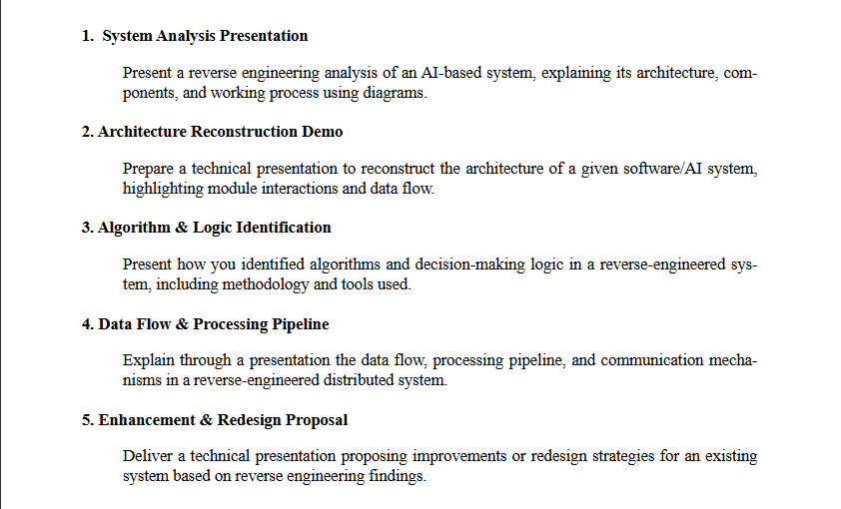
Questions

Slide 3
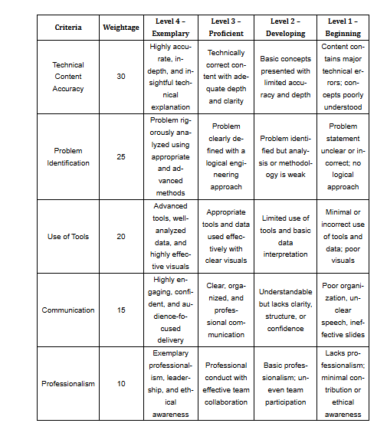
Rubrics for Calculation

Slide 4
Algorithm & Logic Identification
Question
“Reverse Engineering of a Software/AI System”

Slide 5
Introduction
Algorithm & Logic Identification is the process of understanding the algorithms, rules, and decision-making methods used inside an existing software or AI system.
It is an important step in reverse engineering.
The system’s input, processing, and output are studied.
Code, data flow, system behavior, and conditions are analyzed.
The identified logic is used to reconstruct the original system.

Slide 6
Problem Identification
The internal working of an existing software/AI system may not be clearly documented.
It is difficult to identify the algorithms and decision-making rules directly.
The relationship between input, processing, and output needs to be understood.
Different modules may use different algorithms and logic.
Therefore, reverse engineering techniques are required to identify and reconstruct the system logic.

Slide 7
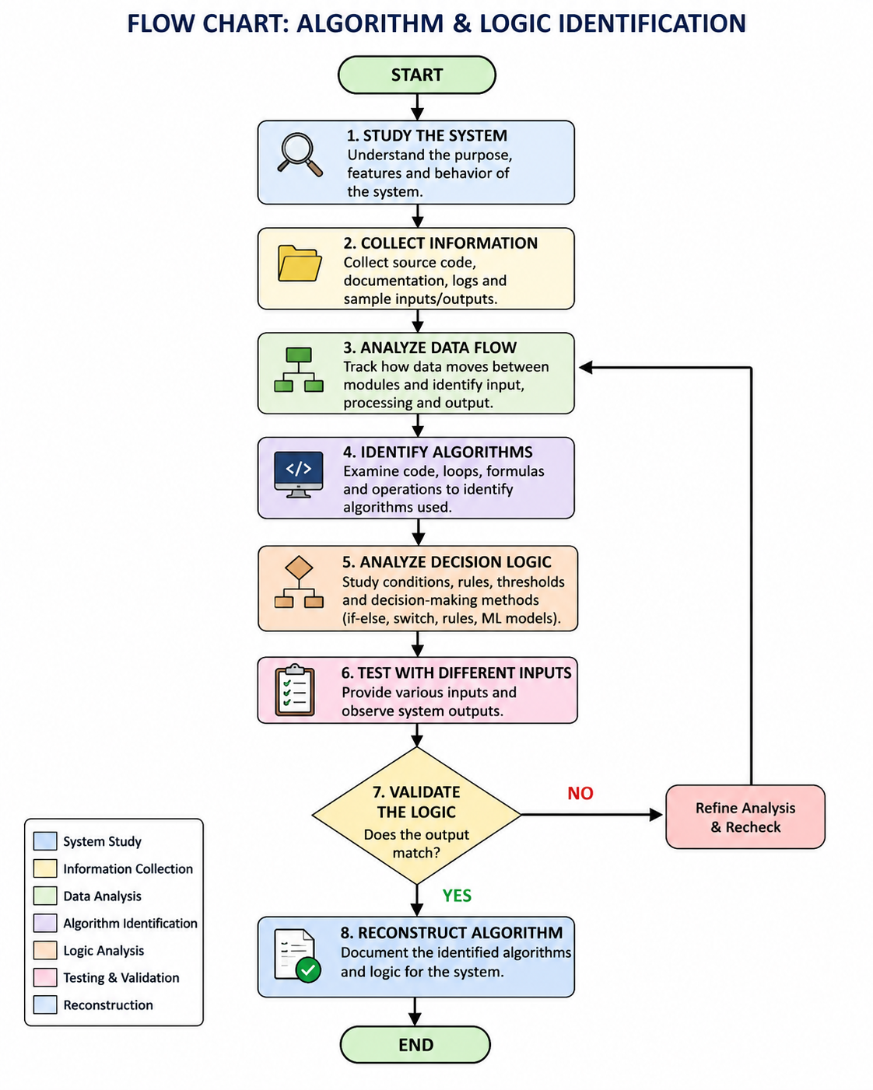
Flow chart

Slide 8
Data Flow
Input
↓
Data Collection
↓
Preprocessing
↓
Algorithm / Model
↓
Decision Logic
↓
Output

Slide 9
Methodology
Methodology for Algorithm & Logic Identification
System Study – Understand the system structure and functions.
Information Collection – Collect source code, logs, inputs, and outputs.
Data Flow Analysis – Trace how data moves between modules.
Algorithm Identification – Identify formulas, loops, models, and processing techniques.
Logic Analysis – Study conditions, rules, thresholds, and decisions.
Testing & Validation – Test with different inputs and compare the outputs.
Reconstruction – Document the identified algorithm and decision logic.
Flow: Study → Collect → Analyze → Identify → Test → Validate → Reconstruct

Slide 10
Tools and Technologies
Tool / Technology | Purpose
Python | Analyze algorithms and AI models
VS Code / IDE | Examine and modify source code
Debugger | Trace program execution and logic
Git | Study code versions and changes
MATLAB / Simulink | Analyze mathematical and system models
UML / Flowchart Tools | Represent system architecture and data flow
Log Analysis | Study system behavior and outputs

Slide 11
Benefits of Architecture Reconstruction
Helps to understand the existing system clearly.
Identifies the algorithms and decision-making logic.
Makes data flow and module interactions easier to understand.
Helps in debugging and finding errors.
Supports system maintenance and improvement.
Makes it easier to reconstruct or upgrade the system.
Reduces the time required to understand complex software.

Slide 12
Conclusion
Algorithm and logic identification helps us understand the internal working of an existing system.
Reverse engineering helps identify algorithms, data flow, and decision-making rules.
Tools such as Python, debuggers, Git, and MATLAB support the analysis.
The identified logic can be validated and reconstructed for further improvement.
Final Statement:
“Understanding the existing logic is the key to successfully reconstructing and improving a system.”

